Slide 1
Datasci in finance
Norman Niemer

Slide 2
Virtuous circle
Passion
Unique ability
Supply / demand

Slide 3
My Background
Early 10s: computer games+admin, coding
Late 10s: tech entrepreneur
Early 20s: finance, M&A
Late 20s: data-driven investment research
Early 30s: data science

Slide 4
What we do
Activity | School Subjects Used
Behavioral analytics | Coding, Optimization, Machine Learning
Alpha generation | Coding, Optimization, Machine Learning, Econometrics
Portfolio/Risk management | Coding, Optimization, Econometrics, "Quant"
Biz dev | Coding
Subjects not learned in school: (software) engineering, investments / markets (CFA), company/market valuation (CFA), AI, marketing/sales

Slide 5
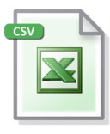

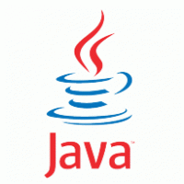
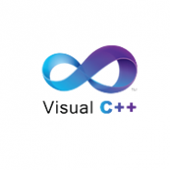
HOW we do it
Reference: Quant stack

Slide 6
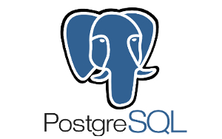

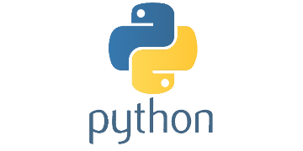

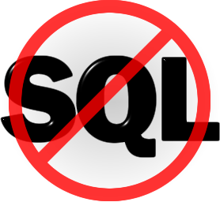
HOW we do it
Datascience stack

Slide 7
Interview process
15mins phone screen
Complete coding test
30mins with team members
Work on creative project
Present project and 30mins with senior managers

Slide 8
Coding test
Pandas munging (ETL): indexing, altering
Pandas computations: grouping, rolling apply
Linux CLI
SQL
Stats: time series modeling
Machine learning: CV, RF
Portfolio Optimization
Bonus: hadoop spark

Slide 9
Coding prep
https://github.com/citynorman/datasci-finance

Slide 10
Datasci beyond finance
Virtual (shopping) assistants (Techcrunch, Mastercard)
VR (Stamford innovation center)
Expertise finding (Fintech #2)
Document tracking (Fintech #1)
Robotics for kids

Slide 11
Datasci in the wild
Cloud / containerization
Unstructured data
Web
NLP
IoT
Deep learning
(Deep) reinforcement learning
AI/Robotics

